Slide 1

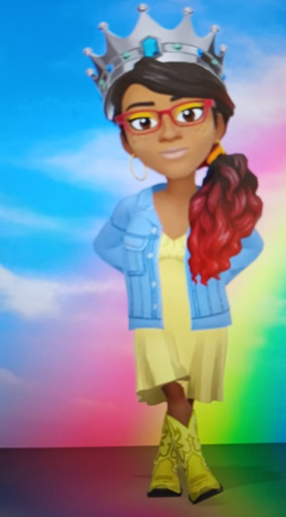
RAINBOW UNIVERSE PAGEANTS & Youth Services
PAGEANT SYSTEM/ORGANIZATION OVERVIEW 2024
Cicely Majeed, CEO/National Director/ Pageant & Life Coach
www.rainbowuniversepageants.com

Slide 2

ABOUT RAINBOW UNIVERSE PAGEANTS & Youth Services
We are an inner beauty pageant system with youth services included
Christian-based foundation
Males & Females ages 13-24; RUP7*17 for ages 7-17
Underserved, disadvantaged, economically challenged, at-risk and others
Pre-pageant workshops for preparation
Community service based
Our brand is rainbows and wings (unity and freedom)
Specific and strict judging procedure
Strict code of conduct and ethics for everyone – inner beauty means we do not focus on superficial beauty (female contestants can only wear natural make-up and must dress modestly)

Slide 3

VISION, MISSION, GOALS
Vision: Same vision as Angelic Rainbow Enterprises – 5 selves (Self-Esteem, Self-Respect, Self-Knowledge, Self-Worth, & Self-Confidence)
Mission: Our mission is to motivate youth to excellence & promote inner beauty through mental, emotional and physical empowerment in our contestants, which is the foundation and goal of each Preliminary, State, and National pageant produced.
Goals: Using our Diamonds 360 strategy our goal is to create a learning atmosphere for youth to understand who they are, embrace their brilliance, improve their self-esteem and become the masterminds they were destined to be. Mind elevation and emotional control is what we are striving for.

Slide 4

Theme/verse
Our theme for this pageant system program is “Self-Esteem”
The verse associated with this program is Esther 5:1-2 which states information about Esther being adorned in her royal robe in the inner court and the golden scepter from the king being extended out to her; also Psalm 73:26 which states how fragile mankind can be in spirit but they can rest assured they are strong in God and therefore their mentality can be strong

Slide 5
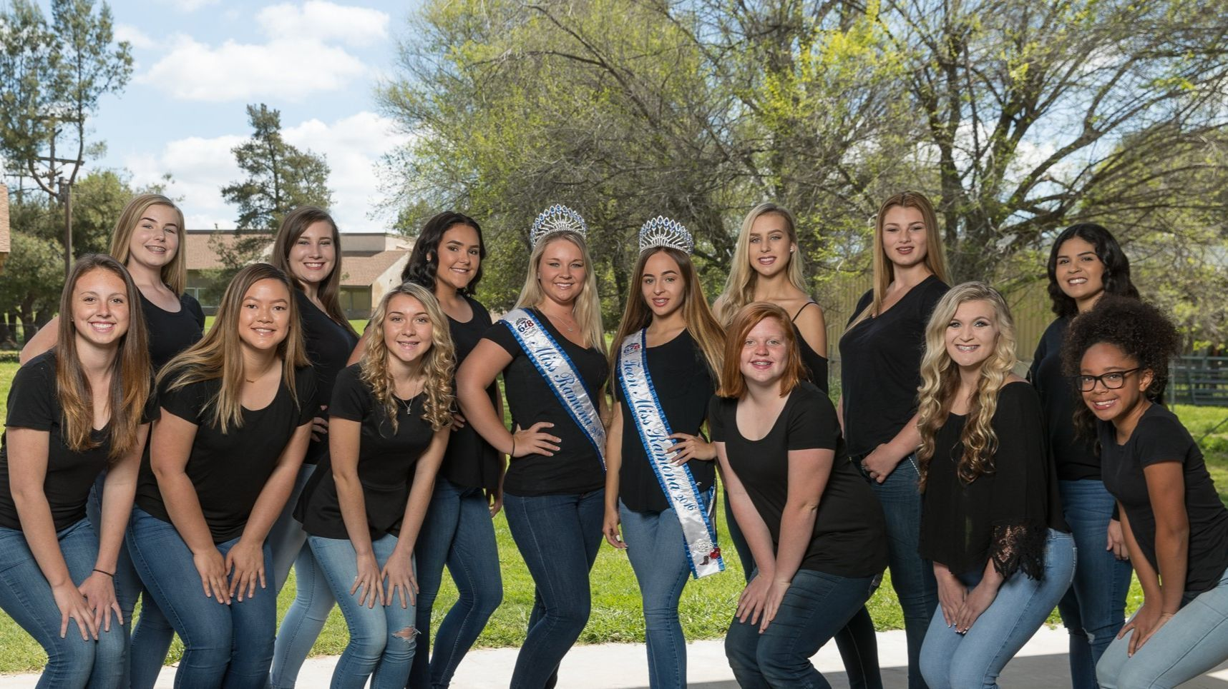
CONTESTANTS
Come from all walks of life, do brain challenges, It Girl/Boy, Rainbow Queen/King & Prince/Princess, parties, retreats, appearances
Females/Males ages 13-24
Three different divisions
  Jr. Miss/Mister 13-15
  Teen Miss/Mister 16-19
  Young Adult Miss/Mister 20-24
Community service platform
Referral cards for new and potential contestants
Orientation and information meetings
Winners get sashes, crowns, tiara’s, gift bags, scholarships (Nationals), flowers, gift cards
Need sponsors for all pageants as registration fee
Rainbow colors and associated Bows instead of categories
Winners from preliminaries advance to State, winners from State advance to Nationals – can have at-large contestants (higher sponsor-based fee)
  Fee schedule

Slide 6

Programs/services
Pre-pageant workshops (prep)
Community service sign ups
Director connections & distributions
Production planning (prelim/state/nationals)
Party planning for contestants & Directors
Sponsorship fundraising
Vendor & Sponsor solicitation
Superhero & Venue coordination
RainbowUP Scholars fund
FunShops/Workshops
Memberships
Various monthly activities

Slide 7

DIRECTORS
Preliminary & State (all 50 states)
Independent contractors (not employees) – get commission from Nationals after one year on board and earn income through own efforts
Employees earn an income and either work at headquarters or in their own home office
Obtain vendors (optional), get a website, and email address to promote pageant, may need insurance if IC
Sign a contract, other forms & choose location of pageant (must have production company or business name) (IC’s only)
Find contestants and sponsors, produce pageant
Pay a franchise fee - $150 for kit and supplies and Extranet access (IC’s only)
Purchase sashes and crowns through National office ONLY
We provide training support, perks, discounts, benefits, commission
Access to intranet/extranet
Need volunteers

Slide 8

PAGEANT INFO
Preliminary pageants have themes – holidays throughout the year
  As many as they want before State in July
  Small pageants, limited activities and requirements
  Winner title is Miss/Mister Rainbow of (city) of California
State – one pageant in each state (also Northern, Southern, Western, Eastern) – state directors can do preliminaries
  Medium sized pageant; more activities and requirements – month of July
  Winner title is Miss/Mister Rainbow of California
Nationals
  One per year – different location every year (produced by national director)
  Directors make commission after one year on board
  Largest pageant – lots of activities throughout one week and more requirements – winner title is Miss/Mister Ultimate Rainbow
Monthly Mini
  One per month – online only pageants February through November
  Registration fee is only $50
  Workshops are online and condensed, choose one community service activity and appearances are not required if you become a title winner
Specialty
  Every six months – can be online or in person
  Youth that are developmentally disabled, physically disabled, mentally ill, cultural, heroic, or LGBTQIA community
  Small pageant like a preliminary; winners reign for six months

Slide 9

VENDORS & SPONSORS
Vendors
Sponsors
For state and nationals (prelim optional)
Provide space in program guide for ads, business cards
Can set up tables with merchandise to acquire new clientele
Pay a fee based on preference
Get exposure on website and at pageants
RainbowUP Wings sponsorship levels (monetary/non-monetary)
Get perks, discounts, business exposure (website exposure)
Recognition at pageants and on social media
Support contestants and pageant system

Slide 10

PRE-PAGEANT WORKSHOPS
Eight pre-pageant workshops for all pageants
  1 main workshop for preliminary pageants (personal development inclusive)
  All 8 for state and nationals (attention, emotions, interviews, service, stage presence, personal development, image consulting, & netiquette/etiquette)
Requirement for all contestants
Preparation for production, interviews, media and other attention & attitude
Can be in person or online depending on location of contestant

Slide 11

BRAINY GALS/GUYS MEMBERSHIP
Contestants can become members and get extended and extra benefits (access to other programs)
  Reinforcement, Connection, Collaboration, Leadership, Mentorship, Guidance, Access to other services
Membership site and forum, access to RainbowUP Mastermind Corner
Free to all registered contestants - lifetime membership with after care programs post production
Must fill out application and agree to guidelines

Slide 12

BRAINY PALS MEMBERSHIP (VOLUNTEERS)
Parents, volunteers (superheroes) can become members and get access to extended and extra benefits (access to other opportunities)
  Support, Teamwork, Leadership, Mentorship, Connection
Membership site, forum, profiles
Free for volunteers – parents of contestants $10
Must agree to guidelines

Slide 13

BENEFITS/PERKS
Movie tickets
Amusement park tickets
Reimbursement for gas (work-related mileage – Volunteer Coordinator only)
Discounts on RUPYS merch
Free classes/courses offered to the public of your choice – through other programs
Free events (exclusive invitations, workshops, parties, special support, goodie bags)
Seniority for future state directors (if eligible)
Restaurant tickets
Gift cards (favorites)
Brainy Pals parties

Slide 14

EVENT STRUCTURE
All pageants are emcee-driven
All state and national pageants are required to have an opening number which can be performed by the contestants or another designated performer
Each level of pageantry has a certain amount of walks on stage, an interview, and Bows, brain challenge, formal wear, etc.
The awards ceremony is performed at the end of every pageant
Tickets are sold at each pageant venue or online on the website – preliminary ($10), state ($20), and nationals ($30)(subject to change and IC’s can set their own ticket fees)

Slide 15

PROGRAM FORMAT
9 Bows and 3 Levels
Preliminary – these are the smallest sized pageants that can be produced in different regional areas and cities in the state where Director resides
Categories/Bows include: 5 plus 3 limited/optional general titles
State – these are larger pageants that can be produced in several different states across the globe
Categories/Bows include: 7 plus 2 limited/optional general titles
Nationals – this is our largest pageant production that can be produced in one geographical area in any state in the U.S.
Categories/Bows include: 9 total – no optional titles

Slide 16

E-STORE
Merchandise – basic pageant stuff (t-shirts, hats, accessories, etc.) – can sell at pageants
No pageant supplies – sashes, crowns, etc. (purchased from special vendor)
Website – directors will have access; limited access to contestants

